Slide 1

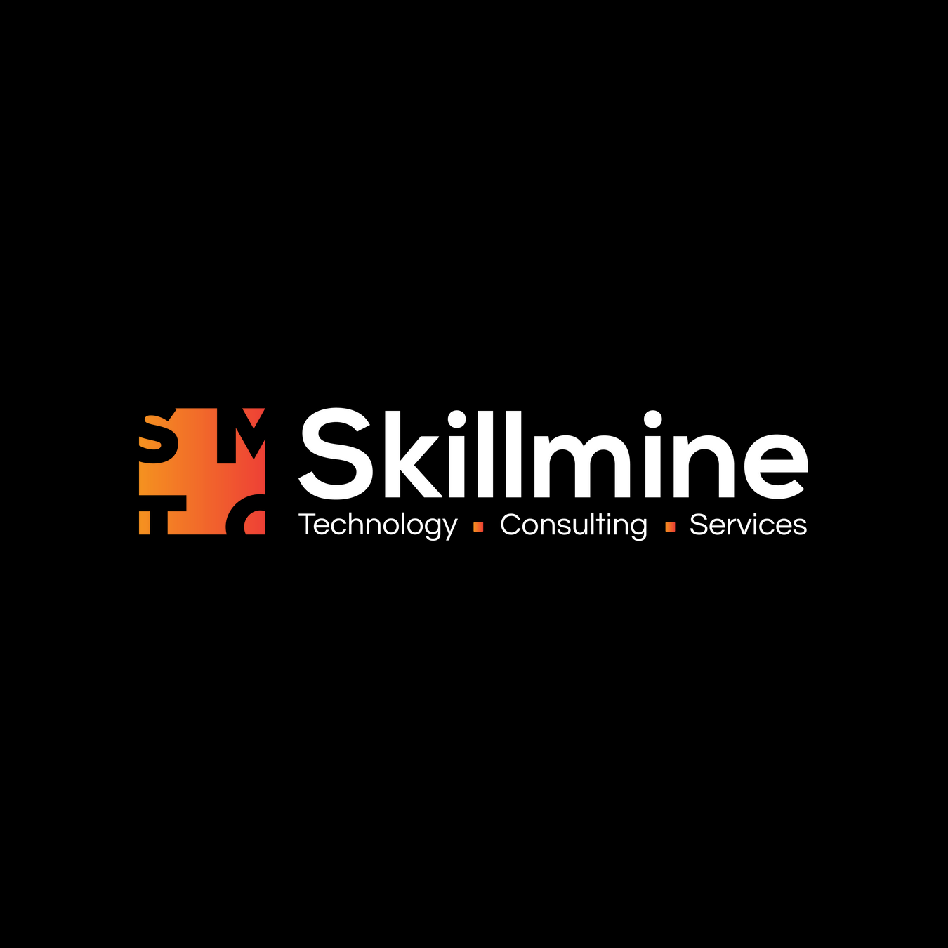

AI-Driven Compliance & GRC Automation Platform
Pre-Sales Enablement
Confidential & Proprietary – Skillmine Technology Consulting Pvt. Ltd.

Slide 2
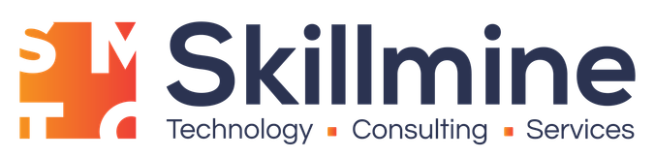

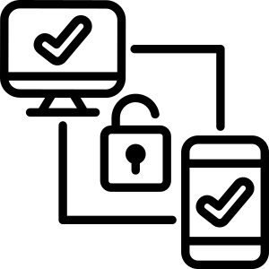

FOUNDATION
Understanding GRC Fundamentals
Governance, Risk, and Compliance form the backbone of organizational resilience. Each pillar serves a distinct purpose, yet true effectiveness comes from integration.
Governance
Risk Management
Compliance
Establishes accountability frameworks and ensures strategic business alignment across all operational levels
Proactively identifies potential threats and implements mitigation strategies to protect organizational assets
Ensures adherence to regulatory requirements, industry standards, and internal policy obligations
COMPLYment unifies all three pillars into one intelligent, integrated system that eliminates silos and creates a holistic view of organizational health.
Confidential & Proprietary – Skillmine Technology Consulting Pvt. Ltd.

Slide 3



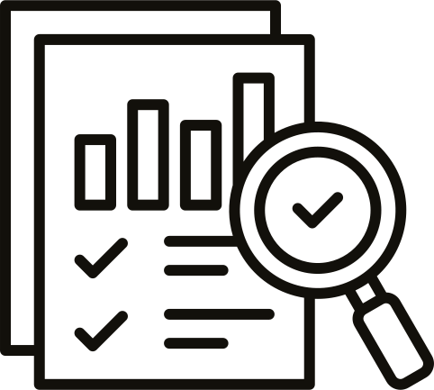
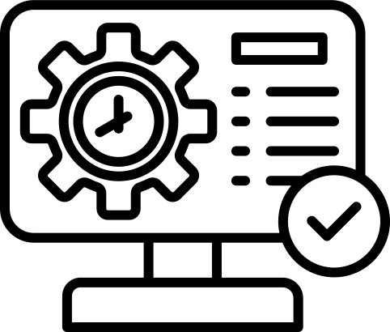

CHALLENGE
Why Traditional GRC Fails Today
Despite significant investments, most organizations struggle with fragmented GRC implementations that create more friction than value.
The Reality Our Customers Face
Evidence scattered across departments, email threads, and multiple repositories
Manual risk tracking in spreadsheets that become outdated within days
Separate tools for audit, compliance, and vulnerability management that don't communicate
No real-time visibility into compliance posture or audit readiness
Low user adoption due to complex workflows and duplicate data entry
The truth: GRC today functions as a compliance checklist, not a strategic value driver
Confidential & Proprietary – Skillmine Technology Consulting Pvt. Ltd.

Slide 4




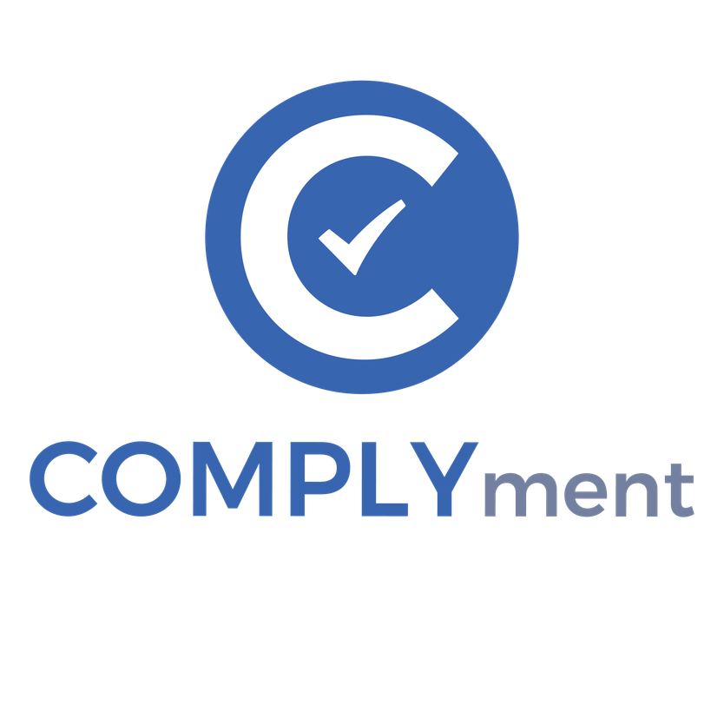




The COMPLYment Platform
A unified intelligent system that consolidates your entire GRC ecosystem into one powerful platform, eliminating tool sprawl and data silos.
Audit Management
Streamlined audit planning, execution, and reporting with automated workflows
Compliance Management
Multi-framework compliance tracking with intelligent control mapping
Risk Management
Comprehensive risk identification, assessment, and treatment tracking
Policy Management
Centralized policy lifecycle with approval workflows and acknowledgment
Asset Management
Complete asset inventory with criticality ratings and ownership
Vulnerability Management
Security vulnerability tracking integrated with compliance requirements
Third-Party Management
Vendor risk assessment and ongoing monitoring capabilities
Document Management
Centralized evidence repository with version control and smart tagging
One integrated system. No more juggling multiple tools or reconciling data across platforms.
Confidential & Proprietary – Skillmine Technology Consulting Pvt. Ltd.

Slide 5

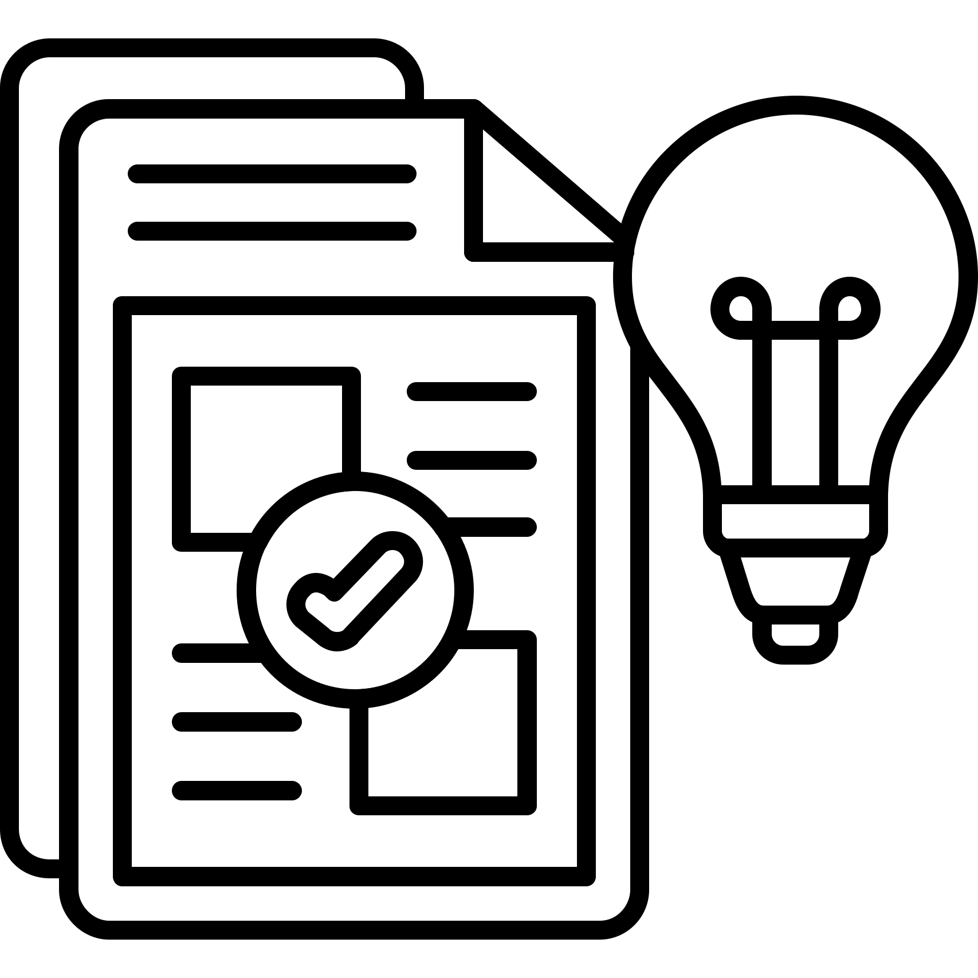



DIFFERENTIATION
What Makes COMPLYment Different
Purpose-built for modern enterprises that demand intelligent automation, not just digitized checklists.
AI-Driven Intelligence
Smart Evidence Suggestions
Cross-Framework Correlation
Machine learning algorithms automatically map controls across frameworks, reducing manual configuration by up to 80%
Context-aware recommendations for controls and evidence based on your industry and compliance requirements
Identify overlapping controls across ISO 27001, SOC 2, GDPR, and 50+ other standards
Real-Time Dashboards
Indian Market Focus
Executive visibility into compliance posture, risk exposure, and audit readiness at a glance
Deep expertise in local regulations with data sovereignty and on-premise deployment options
Confidential & Proprietary – Skillmine Technology Consulting Pvt. Ltd.

Slide 6





Compliance Management Without Duplication
Stop treating each compliance framework as a separate project. COMPLYment's intelligent correlation engine identifies shared controls and evidence requirements across all your certifications.
50+ Pre-Packed Standards
Automatic Control Mapping
Framework Correlation Matrix
ISO 27001, SOC 2, HIPAA, GDPR, PCI-DSS, NIST, and India-specific regulations ready out-of-the-box
AI identifies common controls across frameworks, so you implement once and satisfy multiple requirements
Visual representation
showing how controls overlap, reducing total compliance effort by 40-60%
Statement of Applicability
Readiness Tracking
Auto-generated SoA documents with justifications for included and excluded controls
Real-time progress monitoring with predictive analytics for audit timeline and preparation
Confidential & Proprietary – Skillmine Technology Consulting Pvt. Ltd.

Slide 7



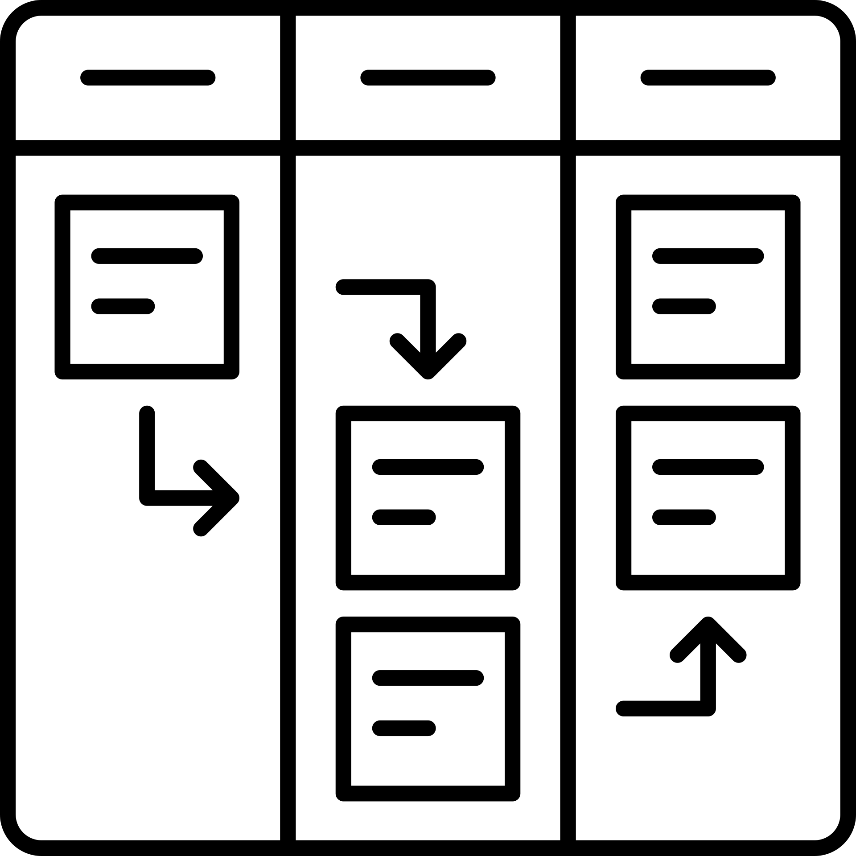
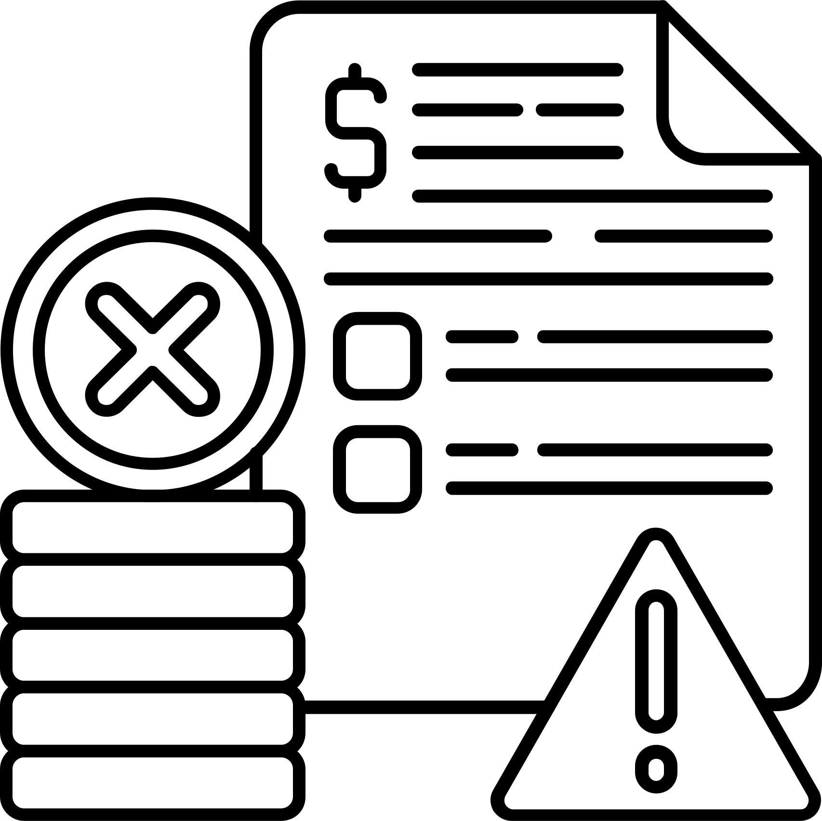
Audit & Evidence Management Made Simple
Transform audit season from chaos to confidence with a centralized evidence repository and intelligent workflow automation.
Central DMS
Control Mapping
Evidence Reuse
Kanban Workflow
Faster Closure
Single source of truth for all compliance evidence with advanced search and tagging
Evidence automatically links to relevant controls across all frameworks
Upload once, apply to multiple audits and compliance requirements
Visual task management that shows exactly where each piece of evidence stands
Reduce audit duration by 50% with organized evidence and automated reminders
Real impact: Our customers report reducing audit preparation time from 8 weeks to 3 weeks on average.
Confidential & Proprietary – Skillmine Technology Consulting Pvt. Ltd.

Slide 8









Risk Management: From Abstract to Actionable
Move beyond static risk registers. COMPLYment connects risks to controls, assets, and vulnerabilities for a dynamic, living risk program.
Control Mapping
Identification
Assessment
Treatment
Monitoring
AI-assisted discovery plus manual input for comprehensive risk inventory
Quantitative and qualitative scoring with customizable risk matrices
Link risks to existing controls and identify coverage gaps
Track mitigation actions with owners, deadlines, and progress
Continuous tracking with automated alerts for changes in risk profile
Executive Risk Dashboard
Leadership needs clarity, not complexity. Our executive view provides:
Heat maps showing risk concentration by department or asset type
Treatment effectiveness metrics
Trend analysis tracking risk posture over time
Board-ready reporting with customizable templates
Confidential & Proprietary – Skillmine Technology Consulting Pvt. Ltd.

Slide 9
Vulnerability & Asset Intelligence
Bridge the gap between security operations and compliance. See exactly how technical vulnerabilities impact your compliance posture and organizational risk.
Asset Inventory
Comprehensive catalog with criticality ratings, ownership, and dependency mapping
Vulnerability Ingestion
Native integrations with Qualys, Nessus, Tenable, and other scanning tools
Ownership Assignment
Automatically assign vulnerabilities to asset owners for faster remediation
Risk Correlation
Link technical vulnerabilities to business risks in your risk register
Compliance Impact
Understand which open vulnerabilities affect specific compliance controls
78%
40%
100%
Faster Remediation
Reduction
Visibility
When security teams see compliance impact
In high-severity vulnerabilities within 6 months
Into asset-level compliance and security posture
Confidential & Proprietary – Skillmine Technology Consulting Pvt. Ltd.

Slide 10
Policy & Governance That Works
Transform policy management from a document graveyard into a living governance framework that drives behavior and ensures accountability.
Complete Policy Lifecycle
Approval Workflow
Multi-level review process with configurable stakeholder routing
Version Control
Complete audit trail of policy changes with before/after comparison
Compliance Mapping
Connect policies to specific controls and regulatory requirements
Acknowledgment
Digital acceptance tracking with automated distribution and reminders
Creation
100+ templates covering security, privacy, HR, and operational policies
100%
60%
85%
Pre-Built Policies
Time Saved
Acknowledgment Rate
Industry-standard templates ready to customize
On policy creation and approval cycles
Automated reminders ensure policy acceptance
Governance in action: Policies aren't just documents—they're mapped to controls, linked to training, and tracked for effectiveness through the platform.
Confidential & Proprietary – Skillmine Technology Consulting Pvt. Ltd.

Slide 11




POLICY & GOVERNANCE
Policy-Driven Compliance at Scale
COMPLYment provides a comprehensive policy management framework that transforms how organizations handle compliance documentation. Our platform includes 100+ pre-built policies covering major regulatory frameworks, ready to deploy and customize.
Built-in approval workflows ensure policy changes flow through proper channels, while version control maintains a complete audit trail. Policies automatically map to compliance requirements, and employee acknowledgment tracking closes the loop on governance.
Employee Acknowledgment
100+ Pre-Built Policies
Approval Workflows
Version Control
Ready-to-use templates for ISO, SOC 2, GDPR, HIPAA and more
Automated routing through maker-checker-approver chains
Complete change history with rollback capabilities
Track and enforce policy acceptance across your organization
Confidential & Proprietary – Skillmine Technology Consulting Pvt. Ltd.

Slide 12
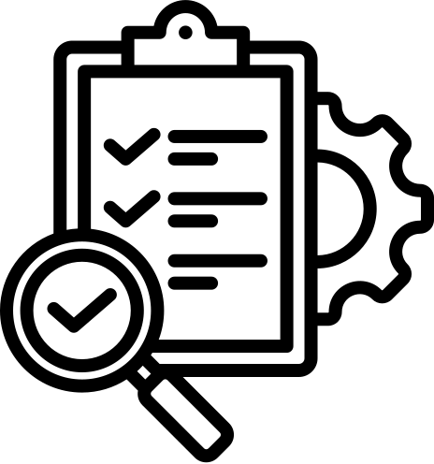
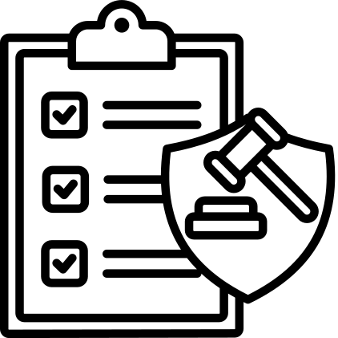
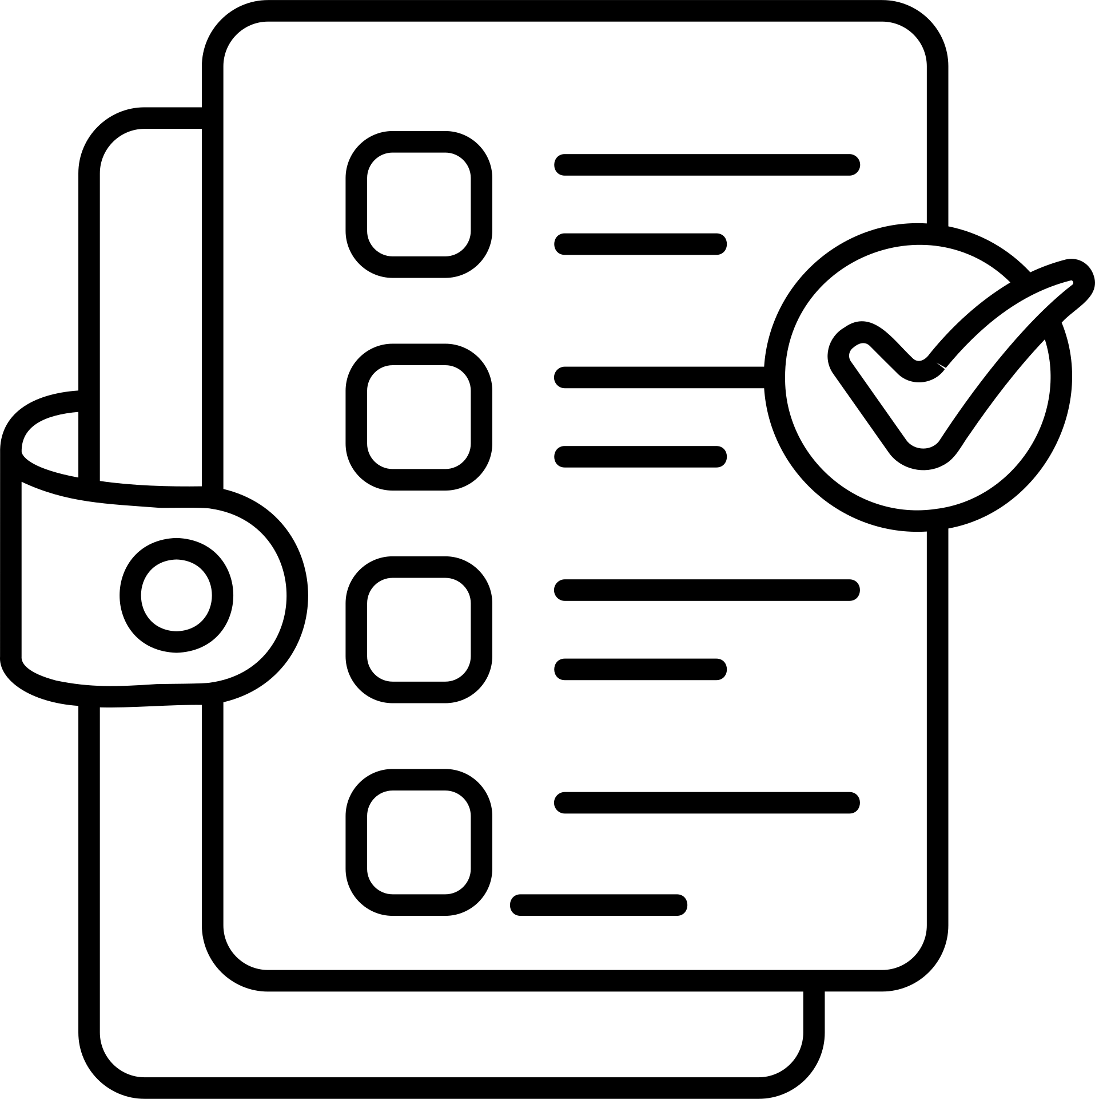
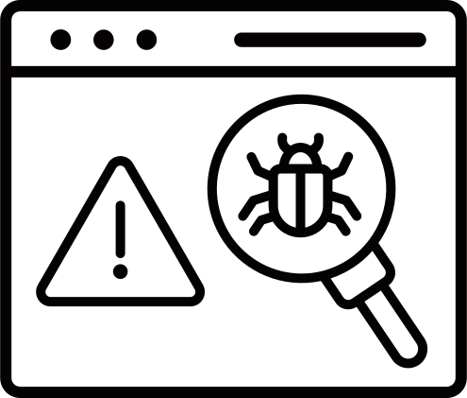
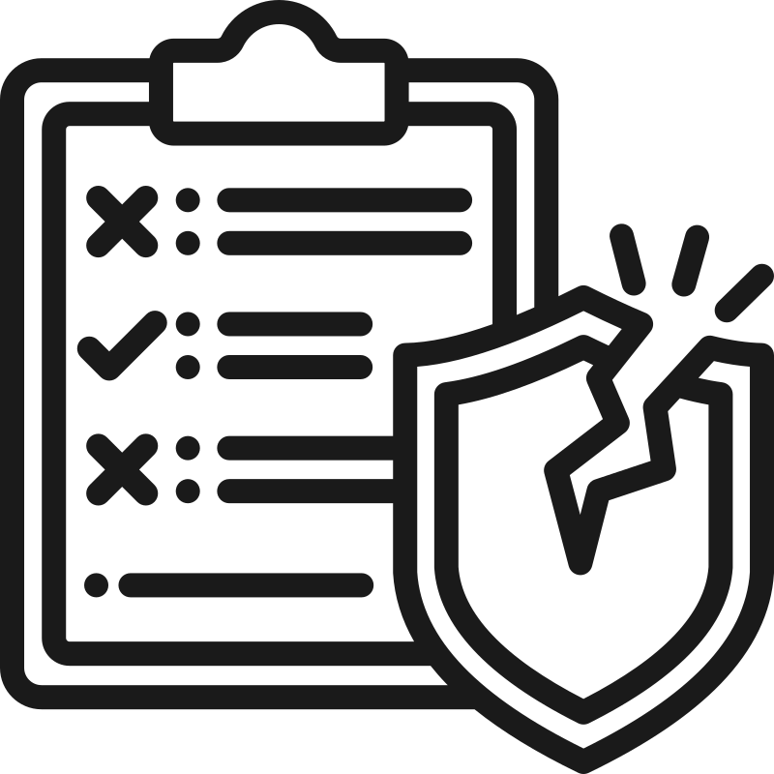
INTEGRATION
One Platform, Zero Silos
COMPLYment breaks down traditional data barriers by creating a single source of truth across your entire GRC ecosystem. Every module communicates seamlessly, eliminating duplicate data entry and ensuring consistency.
Audit ↔ DMS
Compliance ↔ DMS
Compliance ↔ Policy
Vulnerability ↔ Risk
Assets ↔ Vulnerability
Audit findings link directly to evidence documents
Controls pull evidence automatically from document library
Requirements map to governing policies instantly
Security gaps feed risk assessments in real-time
Asset inventory connects to vulnerability scans
Key Benefit: Upload evidence once, use it everywhere. No duplicate uploads. No data silos. No reconciliation headaches.
Confidential & Proprietary – Skillmine Technology Consulting Pvt. Ltd.

Slide 13

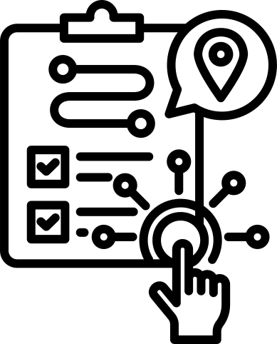

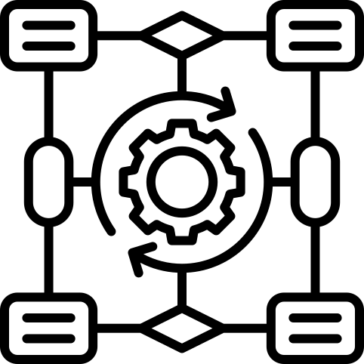

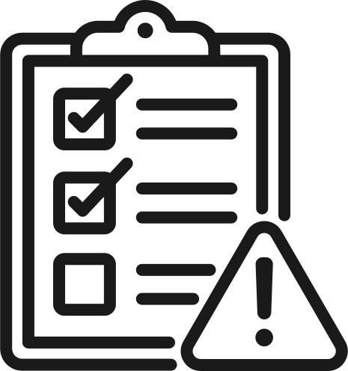
WORKFLOW EXAMPLE
How Everything Works Together
See COMPLYment's intelligent automation in action. When new regulations emerge, our platform orchestrates a seamless compliance response across all connected modules.
New Regulation Introduced
Compliance Controls Assigned
Evidence Uploaded Once
System identifies applicable requirements and notifies compliance team
AI suggests relevant controls and maps them to existing frameworks
Supporting documentation enters the centralized document management system
Auto-Mapped Across Frameworks
Audit Pulls Evidence Directly
Risk & Vulnerability Aligned
Evidence automatically links to ISO 27001, SOC 2, and other relevant controls
Auditors access pre-mapped evidence without manual collection
Platform updates risk scores and vulnerability tracking automatically
Confidential & Proprietary – Skillmine Technology Consulting Pvt. Ltd.

Slide 14
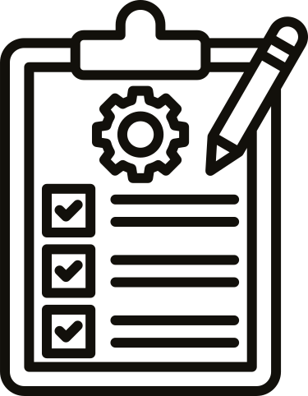

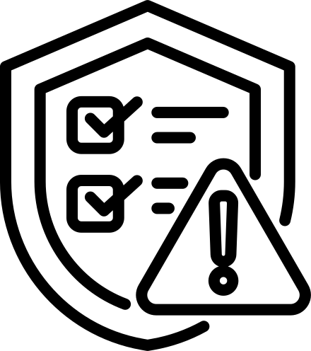

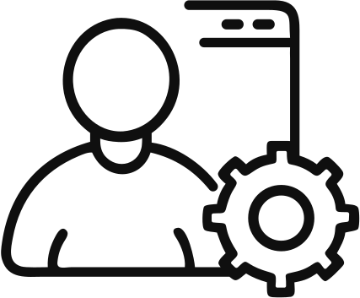
Who Uses COMPLYment
COMPLYment supports specialized roles with tailored permissions and workflows. Our maker-checker-auditor architecture ensures separation of duties while maintaining operational efficiency.
Compliance Manager
Maker
Checker
Oversees frameworks, assigns controls, monitors compliance health, and generates executive reports
Creates and updates compliance documentation, uploads evidence, and initiates workflow approvals
Identify overlapping controls across ISO 27001, SOC 2, GDPR, and 50+ other standards
Auditor
Admin
Accesses read-only evidence, conducts assessments, and documents audit findings
Manages user access, configures system settings, and maintains platform security
Built-in Segregation: The maker-checker-auditor workflow ensures no single user can create, approve, and audit the same control—critical for regulatory compliance.
Confidential & Proprietary – Skillmine Technology Consulting Pvt. Ltd.

Slide 15


ARCHITECTURE
Enterprise-Grade Platform Built for Scale
COMPLYment runs on a modern, secure technology stack designed for enterprise reliability and performance. Our architecture supports thousands of concurrent users while maintaining sub-second response times.
Frontend: Angular
Backend: NestJS
Database: MongoDB
Responsive, intuitive interface with real-time updates
Robust API layer with integrated AI services
Flexible, scalable NoSQL architecture for complex compliance data
Role-Based Access Control
Comprehensive Audit Logs
Data Segregation
Granular permissions ensure users see only what they need
Every action tracked with timestamp, user, and change details
Multi-tenant architecture with strict data isolation
Confidential & Proprietary – Skillmine Technology Consulting Pvt. Ltd.

Slide 16


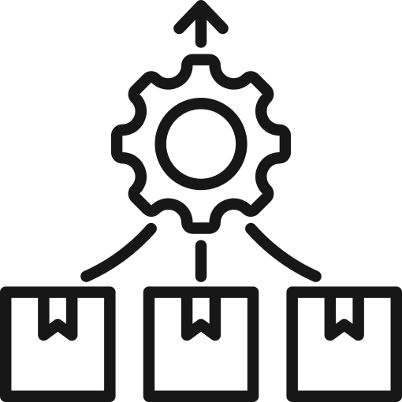

INNOVATION ROADMAP
The Future of Intelligent Compliance
COMPLYment's AI-powered roadmap transforms reactive compliance into proactive risk management. Our upcoming features leverage machine learning to eliminate manual work and provide predictive insights.
AI Control Mapping
Evidence Extraction
Auto Risk Identification
Vulnerability Consolidation
Predictive Compliance Health
Machine learning automatically maps requirements across frameworks, reducing manual effort by 80%
Natural language processing pulls key data from documents, populating controls automatically
AI analyzes patterns to surface emerging risks before they become critical issues
Intelligent aggregation of security findings from multiple scanning tools
Forecasting models predict compliance gaps weeks before audits
Confidential & Proprietary – Skillmine Technology Consulting Pvt. Ltd.

Slide 17





Why Customers Choose COMPLYment
Organizations select COMPLYment because it delivers measurable ROI from day one. Our platform transforms compliance from a cost center into a strategic advantage.
One Platform for All GRC
Real-Time Compliance View
Lower
Consulting Dependency
Faster Audits
Less Manual Effort
Cut audit preparation time by 60% with pre-mapped evidence and automated reporting
Eliminate repetitive tasks through intelligent automation and workflow optimization
Link risks to existing controls and identify coverage gaps
Executive dashboards provide instant visibility into compliance posture across all frameworks
Built-in expertise and automation reduce reliance on expensive external consultants
Before COMPLYment
After COMPLYment
6-8 weeks audit prep
2-3 weeks audit prep
Multiple disconnected tools
Single integrated platform
Heavy consultant relianc
Self-sufficient teams
Confidential & Proprietary – Skillmine Technology Consulting Pvt. Ltd.

Slide 18
PARTNER SUCCESS
Why Partners Win with COMPLYment
COMPLYment creates lasting partnerships through sticky products and natural expansion opportunities. Our platform's comprehensive module ecosystem drives long-term revenue growth.
Sticky Compliance Workloads
Expansion Across Modules
Long-Term Customer Engagement
High Differentiation vs Legacy GRC
Compliance is continuous, not a one-time project. Customers renew and expand as regulations evolve and frameworks multiply.
Start with one framework, grow to comprehensive GRC. Natural upsell paths from compliance to risk, audit, and vulnerability management.
Deep platform integration creates switching costs. Partners build lasting relationships with predictable recurring revenue.
Modern architecture and AI capabilities set partners apart from outdated competitors. Win deals based on innovation, not just price.
3.2x
94%
40%
Average Expansion
Annual Retention
Partner Margins
Customers grow from 1 to 3+ modules within 18 months
Industry-leading renewal rates driven by platform stickiness
Attractive economics on implementation and ongoing services
Confidential & Proprietary – Skillmine Technology Consulting Pvt. Ltd.

Slide 19
Key Takeaways for Pre-Sales Success
COMPLYment is automation-first GRC
Unlike legacy platforms built for manual processes, we eliminate repetitive work through intelligent workflows and AI-powered insights.
AI removes compliance duplication
Machine learning identifies overlapping requirements and suggests control reuse across frameworks, cutting implementation time dramatically.
Evidence is reusable across all frameworks
Upload once, use everywhere. A single document can satisfy requirements in ISO 27001, SOC 2, GDPR, and HIPAA simultaneously.
Risk, vulnerability & audit are truly linked
Real integration, not just data imports. Changes in one module instantly update related items across the entire platform.
Move from periodic audits to continuous compliance
Real-time dashboards and automated monitoring shift organizations from reactive to proactive compliance management.
Competitive Positioning: When prospects compare us to ServiceNow or Archer, emphasize our purpose-built compliance focus, modern UX, and AI-first approach—not retrofitted enterprise IT tools.
Confidential & Proprietary – Skillmine Technology Consulting Pvt. Ltd.

