Slide 1

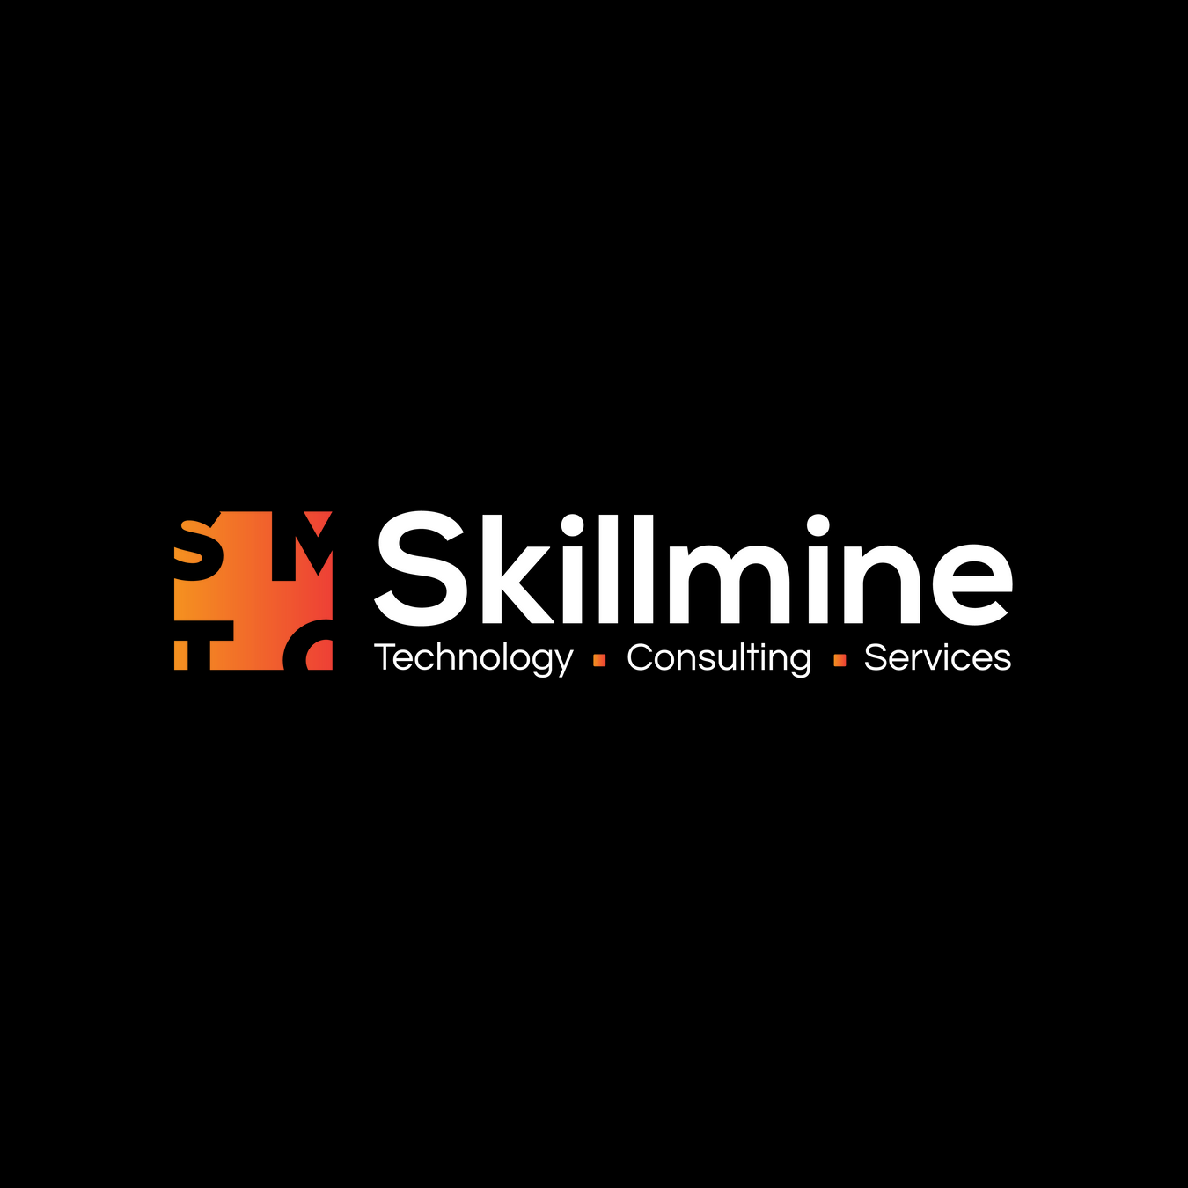

AI-Driven GRC & Compliance Automation Platform
Sales Enalement
Confidential & Proprietary – Skillmine Technology Consulting Pvt. Ltd.

Slide 2
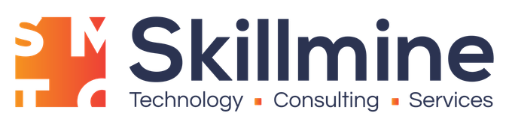

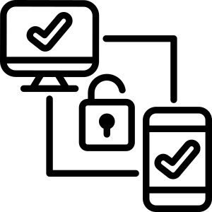


FOUNDATION
Why GRC Matters
Governance, Risk, and Compliance form the foundation of enterprise resilience. COMPLYment unifies all three into a single intelligent platform that drives business value.
Governance
Risk
Compliance
Align business strategy with IT execution. Ensure decisions are made with full visibility and accountability across the organization.
Protect enterprise value by identifying, assessing, and mitigating threats before they impact operations or reputation.
Meet regulatory obligations efficiently with automated tracking, evidence collection, and real-time reporting capabilities.
Confidential & Proprietary – Skillmine Technology Consulting Pvt. Ltd.

Slide 3


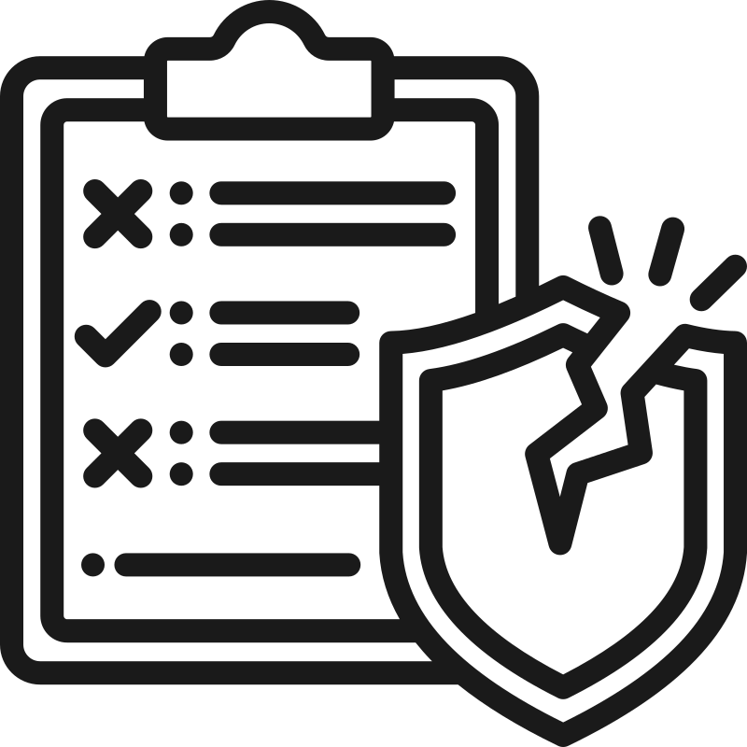


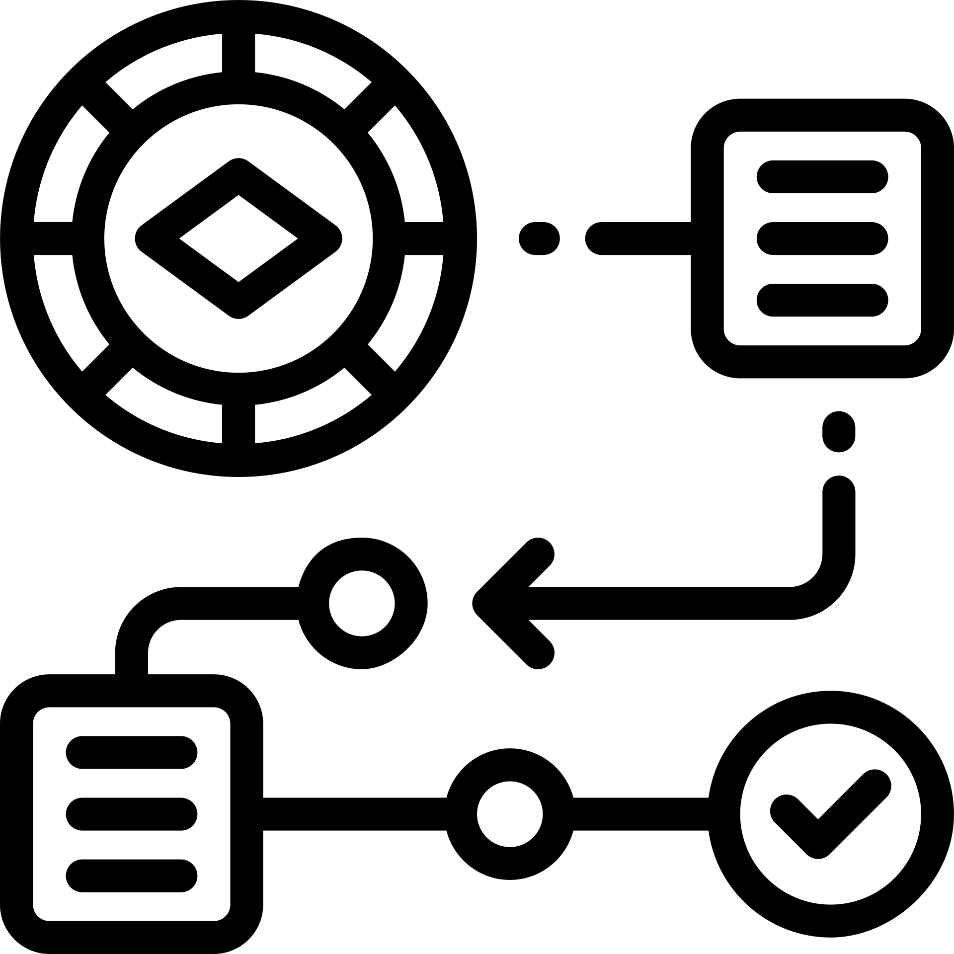
How GRC Works Today
The Reality
Evidence scattered across multiple teams and systems
Manual risk tracking in spreadsheets
Separate tools for audit, compliance, and vulnerabilities
Compliance reporting takes weeks to compile
Low user adoption due to complexity
GRC today is seen as an obligation, not a source of business value. Organizations struggle with fragmented processes and inefficient workflows.
Confidential & Proprietary – Skillmine Technology Consulting Pvt. Ltd.

Slide 4

Introducing COMPLYment
COMPLYment is a unified, AI-enabled GRC platform that transforms compliance from burden to business advantage. Reduce compliance effort by up to 60%, increase visibility across your entire risk landscape, and automate governance workflows that once consumed weeks of manual effort.
Unified Platform
One system for all GRC needs
AI-Enabled
Intelligent automation at every step
Enterprise-Ready
Scales with your organization
Confidential & Proprietary – Skillmine Technology Consulting Pvt. Ltd.

Slide 5


Built for Enterprise Needs
COMPLYment offers flexible deployment options to match your security requirements, infrastructure preferences, and operational constraints.
On-Premises
Cloud (SaaS)
Complete data control and security. Full customization to meet specific regulatory requirements. Ideal for highly regulated industries and organizations with strict data residency needs.
Fast deployment with zero infrastructure overhead. Automatic updates and seamless scalability. Lower total cost of ownership with predictable subscription pricing.
Whether you're a regulated financial institution or a cloud-first technology company, COMPLYment adapts to your environment.
Confidential & Proprietary – Skillmine Technology Consulting Pvt. Ltd.

Slide 6







One Integrated GRC Platform
Replace fragmented tools with a comprehensive solution that covers every aspect of governance, risk, and compliance.
Audit Management
Streamline audit workflows and evidence collection
Compliance Management
Track obligations across 50+ frameworks
Risk Management
Identify and mitigate enterprise risks
Policy Management
Centralize policy lifecycle and approvals
Asset Management
Maintain complete asset inventory
Vulnerability Management
Consolidate and track security findings
Third-Party Management
Assess and monitor vendor risks
Document Management
Secure DMS with version control
Confidential & Proprietary – Skillmine Technology Consulting Pvt. Ltd.

Slide 7




DIFFERENTIATORS
Why Customers Choose COMPLYment
AI-Driven Control Mapping
Automatically map controls across multiple frameworks, eliminating hundreds of hours of manual work.
Auto-Suggestions & Correlations
Intelligent recommendations based on your compliance context and industry best practices.
Real-Time Dashboards
Executive visibility into compliance posture, risk exposure, and audit readiness at any moment.
Kanban-Based Workflows
Intuitive task management that teams actually want to use, driving higher adoption rates.
Data Sovereignty & Make-in-India
Built for Indian enterprises with local data residency and compliance with domestic regulations.
Confidential & Proprietary – Skillmine Technology Consulting Pvt. Ltd.

Slide 8
Automation That Matters
COMPLYment's AI capabilities transform compliance from a manual, reactive process into an intelligent, proactive system.
AI Control Mapping
Automatically map controls across ISO 27001, SOC 2, NIST, GDPR, and 50+ other frameworks
01
02
Auto-Tagging Evidence
Intelligent categorization and linking of evidence to relevant controls
Predictive Insights
Forecast compliance gaps and recommend preventive actions
03
04
Risk Identification
Analyze data patterns to surface hidden risks before they escalate
Vulnerability Consolidation
Aggregate findings from multiple security tools into unified view
05
Confidential & Proprietary – Skillmine Technology Consulting Pvt. Ltd.

Slide 9



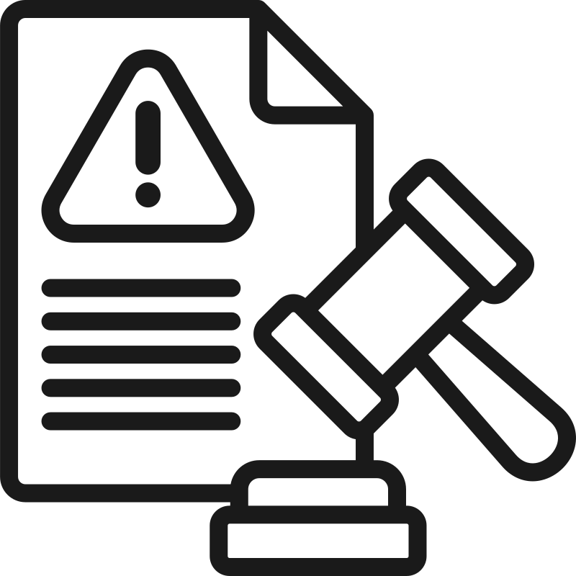

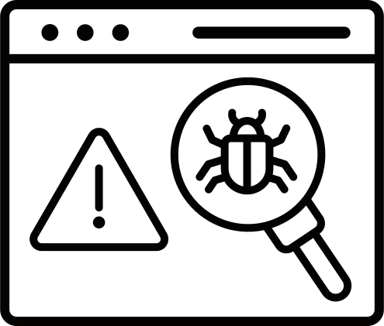
What Customers Get
50+ Regulatory Standards
Real-Time Dashboards
Faster Audits
Pre-built frameworks including ISO 27001, SOC 2, HIPAA, PCI DSS, GDPR, and more
Executive and operational views with drill-down capabilities
Evidence collection and audit workflows that cut preparation time in half
Asset & Vulnerability Visibility
Risk-Driven Compliance
Policy Lifecycle
Prioritize compliance activities based on actual risk exposure
Automated review cycles, approvals, and attestation tracking
Complete inventory with risk scoring and remediation tracking
Plus: Vendor risk assessments, third-party monitoring, security awareness training, and integrated learning management.
Confidential & Proprietary – Skillmine Technology Consulting Pvt. Ltd.

Slide 10


What Customers Experience
COMPLYment delivers measurable business outcomes that transform GRC from cost center to strategic advantage.
40-60%
3x
85%
Reduction in Audit Effort
Faster Audit Closures
Fewer Compliance Gaps
Automated evidence collection and AI-driven control mapping eliminate manual work
Streamlined workflows and real-time collaboration accelerate completion
Predictive insights and continuous monitoring prevent issues before audits
Reduced Consulting Dependency
Built-in expertise and automation reduce reliance on expensive external consultants
Improved Governance Maturity
Structured frameworks and best practices elevate organizational GRC capabilities
Confidential & Proprietary – Skillmine Technology Consulting Pvt. Ltd.

Slide 11
PLATFORM EVOLUTION
From Basic to Brilliant: The COMPLYment Transformation
Legacy Platform Limitations
  Basic rule-based automation with rigid workflows
  Limited compliance standards coverage
  Heavy reliance on manual processes and spreadsheets
  Disconnected tools requiring constant data reconciliation
Next-Generation COMPLYment
  AI-powered intelligent compliance automation
  Real-time executive dashboards with actionable insights
  Seamless scanner and security tool integrations
  Intuitive guided workflows that reduce training time
The new COMPLYment represents a complete reimagining of GRC automation—moving from reactive compliance management to proactive, intelligent risk mitigation that scales with your enterprise.
Confidential & Proprietary – Skillmine Technology Consulting Pvt. Ltd.

Slide 12
Your Ideal COMPLYment Customer Profile
Target Industries & Segments
COMPLYment delivers maximum value to enterprises operating in heavily regulated environments where compliance complexity directly impacts business velocity and risk exposure.
Banking, Financial Services & NBFCs
Organizations navigating RBI regulations, ISO 27001, PCI-DSS, and evolving digital lending frameworks
Key Buying Signals
  Managing 3+ concurrent regulatory frameworks
  Rapid growth requiring scalable compliance
  Recent audit findings or regulatory scrutiny
  Expanding into new regulated markets
  C-suite commitment to operational excellence
Manufacturing & Pharmaceutical
Companies managing FDA compliance, Good Manufacturing Practices, ISO standards, and supply chain security
Technology & FinTech
Fast-scaling IT services, SaaS platforms, and FinTech innovators requiring SOC 2, ISO 27001, and data privacy compliance
Confidential & Proprietary – Skillmine Technology Consulting Pvt. Ltd.

Slide 13

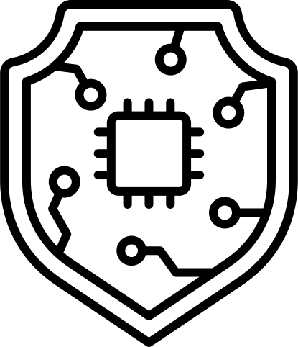
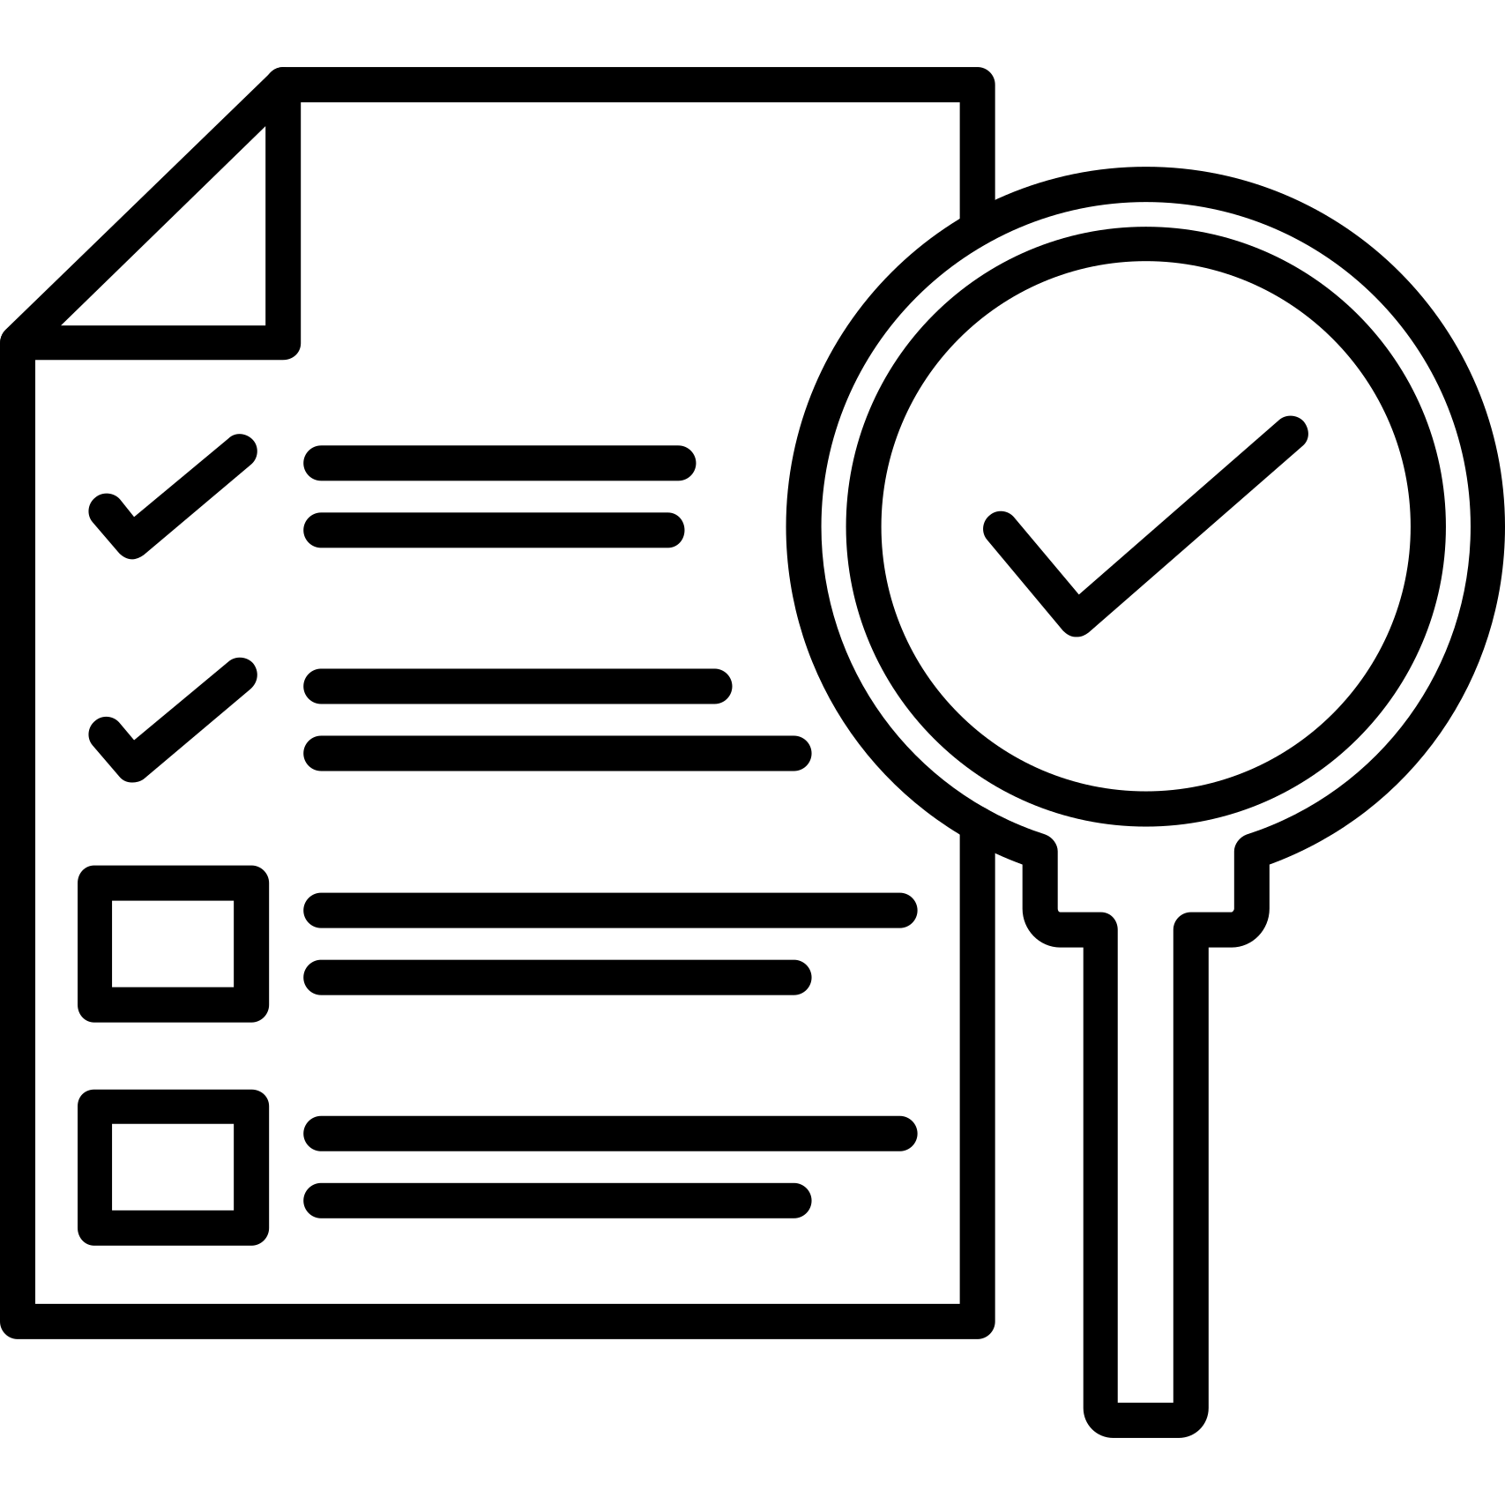

Why COMPLYment Dominates the Competitive Landscape
Lightweight & Agile
AI-Powered Intelligence
Deploy in weeks, not months. Unlike bloated legacy GRC platforms, COMPLYment offers enterprise power without enterprise complexity—faster implementation, quicker ROI, and lower total cost of ownership.
Go beyond simple compliance-only tools with machine learning that eliminates duplicate work, predicts risks, and continuously optimizes your compliance posture without manual intervention.
APAC-First Design
Automation Excellence
Purpose-built for Indian and Asia-Pacific regulatory environments. Native support for RBI, SEBI, IRDAI, ISO, and regional standards—not an afterthought or localization add-on.
Deep integrations with security scanners, SIEM tools, and enterprise systems create true end-to-end automation. Compliance becomes embedded in operations, not a separate burden.
"COMPLYment sits at the perfect intersection: more powerful than point solutions, more nimble than enterprise suites, and more intelligent than both."
Confidential & Proprietary – Skillmine Technology Consulting Pvt. Ltd.

Slide 14



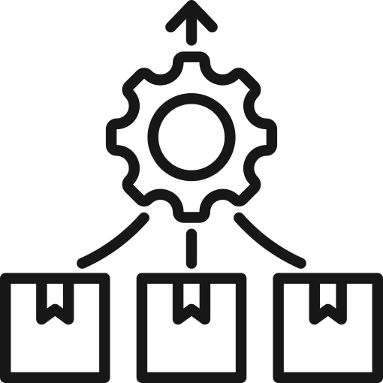

Your Sales Playbook: Key Messages That Win Deals
Pain Point Recognition
The Complete Solution
AI Efficiency Advantage
Start every conversation here: Manual compliance is killing productivity and increasing risk. Customers lose weeks to spreadsheets, duplicate data entry, and audit preparation chaos.
COMPLYment automates the entire GRC lifecycle—from control mapping and evidence collection to continuous monitoring and audit reporting. One integrated platform, zero gaps.
Intelligent automation eliminates up to 70% of redundant compliance work. Our AI identifies overlapping requirements across frameworks and auto-maps evidence to multiple controls simultaneously.
Consolidation Value
Expansion Opportunity
Replace 5-7 disparate tools with a single platform. Stop paying for separate policy management, risk registers, audit tools, and compliance trackers. Lower costs, higher visibility.
Strong land-and-expand model with modular architecture. Start with core compliance, then upsell risk management, vendor assessment, incident response, and third-party risk modules as needs evolve.
Closing Strategy
Position COMPLYment as a strategic investment, not a cost center. Frame the ROI around recovered productivity, reduced audit fees, and eliminated breach risk—not just compliance checkboxes.
Confidential & Proprietary – Skillmine Technology Consulting Pvt. Ltd.

